Slide 1
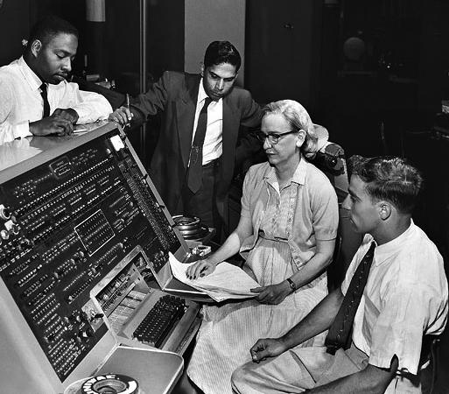
COBOL: The Language that Changed the World of Business
Written and researched by Connor Schuetz, Charles Serrao, Mateo Jacome, and Zoe Astifidis

Slide 2
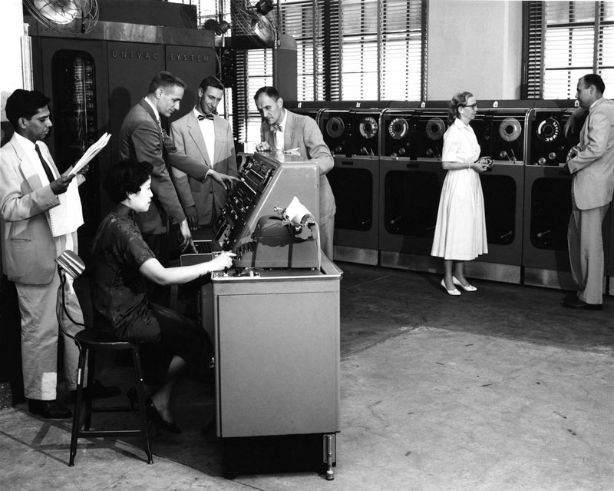
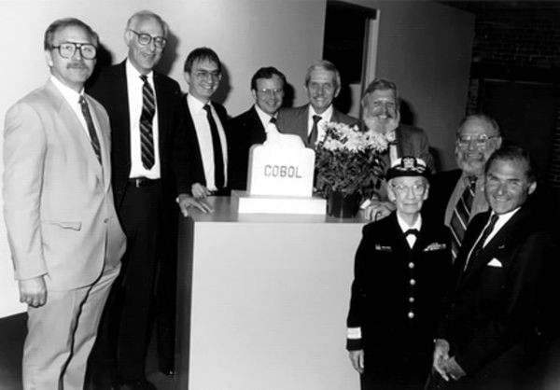

Who Invented it?
Cobol is a programming language created in the year 1960.
It was designed by the corporation CODASYL Committee (Conference on Data Systems Languages). (China, Goodwin, 2024)

Slide 3
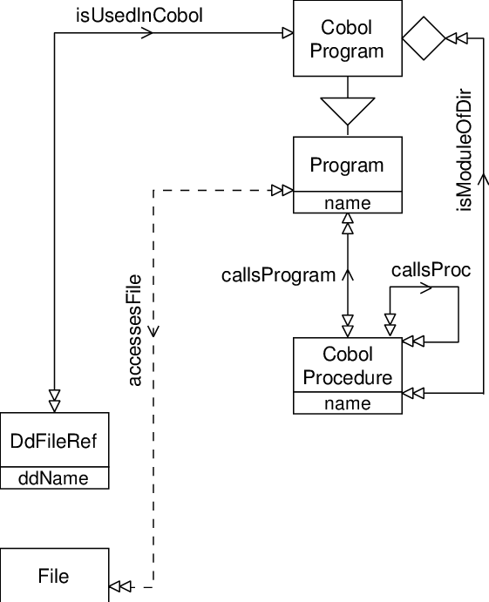
COBOL was the solution for…
Cobol was designed with the intent in mind to have the ability to run on multiple different types of computer systems. Cobol was one of the first languages to incorporate English instead of machine code as was usual in many of the other programming languages of the time. (Kidwell, 2010)

Slide 4
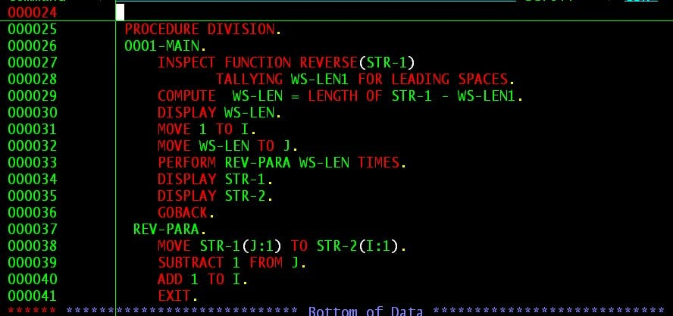
It was Huge Success!
What made COBOL so successful?
Ability to run on more than 1 type of computer
Syntax looks like english--easy to understand!
Ability to track and organize data--data types were strings of characters and numbers.

Slide 5



Is its still alive today?
COBOL is still in use by financial institutions and government agencies. Notable companies are:
USAA
IBM
JPMorgan Chase
Heise Online
Sourced from (“COBOL”)
Notes:
Connor Presents : )

Slide 6



Interesting Facts
More modern programming languages are being used replacing the legacy mainframes that use COBOL. This is a costly endeavor as 75% of rewrite programs on legacy COBOL systems fail to the cost.(Brunskill)
220 billion lines of COBOL are still in use by businesses today.
90% percent of Fortune 500 companies still use COBOL. It is still the force behind 95% of ATM transactions (Fehérvári, 2022)
Notes:
Connor Presents : )

Slide 7
Sources
Brunskill, Vicki-Lynn, and Tr&eacute;a Lavery. “What Is COBOL (Common Business Oriented Language)? Definition from Searchitoperations.” IT Operations, TechTarget, 8 Oct. 2021, www.techtarget.com/searchitoperations/definition/COBOL-Common-Business-Oriented-Language#:~:text=By%201970%2C%20COBOL%20had%20become,institutions%20and%20by%20government%20agencies.
“COBOL.” Companies Using COBOL, Market Share, Customers and Competitors, discovery.hgdata.com/product/cobol. Accessed 28 Aug. 2024.
Ferguson, A. (2019). A History of Computer Programming Languages. Brown.edu. https://cs.brown.edu/~adf/programming_languages.html
Zoltán Fehérvári. (2022, August 24). The Common Business Oriented Language (COBOL), which was designed largely for business purposes, is still alive and well, moving quietly among the major computer languages. Many believe it is on its way out. Linkedin.com. https://www.linkedin.com/pulse/what-cobol-facts-you-didnt-know-zolt%C3%A1n-feh%C3%A9rv%C3%A1ri
50 years of running COBOL. (2010, December 6). Si.edu. https://americanhistory.si.edu/explore/stories/50-years-running-cobol
COBOL | computer language. (n.d.). Encyclopedia Britannica. https://www.britannica.com/technology/COBOL
China, C. R., & Goodwin, M. (2024, April 19). What is COBOL? Retrieved September 2, 2024, from https://www.ibm.com/topics/cobol
Kidwell, P. (2010, December 6). 50 years of running COBOL. Smithsonian National Museum of American History. Retrieved September 1, 2024, from https://americanhistory.si.edu/explore/stories/50-years-running-cobol

